Slide 1
Writing Claims
“Comprising” – including but not limited to
“Consisting of” – this and only this
First time something’s mentioned: “a”/ “an”
Subsequent mentions: “the” or “said”

Slide 2
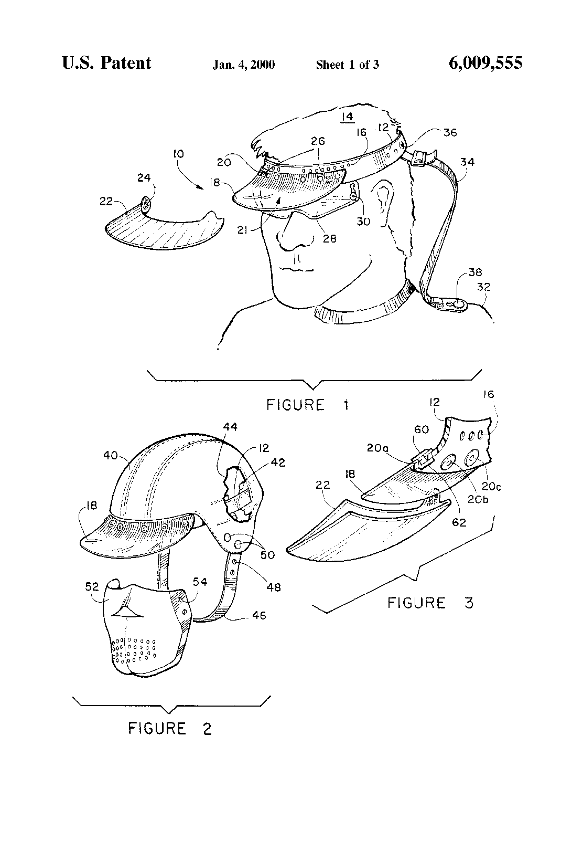
U.S. Patent No. 6,009,555
A headgear apparatus to be worn by a user comprising:
a headband member for fitting about a user’s head, said headband having a frontal portion adapted to substantially extend across the forehead of a user;
a visor member removably secured to said frontal portion of said headband, said visor member independently extendable from said headband;

Slide 3
U.S. Patent No. 6,009,555
A headgear apparatus to be worn by a user comprising:
a headband member for fitting about a user’s head, said headband having a frontal portion adapted to substantially extend across the forehead of a user;
a visor member removably secured to said frontal portion of said headband, said visor member independently extendable from said headband;

Slide 4
U.S. Patent No. 6,009,555
Dependent Claims:
4. A headgear apparatus as recited in claim 1, wherein said headband member is formed from neoprene fabric.
9. A headgear apparatus as recited in claim 4, further comprising a cord for connecting said headband to a piece of wearing apparel of a user.

